Slide 1

AI Pair Programming Text-to-Code
April 2022

Slide 2
Context Why are we here?
Current conditions in technology are pushing the industry to find new ways AI can contribute.
MOTIVATIONS
Lack of skilled resources
As digital transformation progress, companies are struggling to satisfy their needs in terms of human resources
Advanced Models
Transformers, and specifically GPT-3, had presented huge achievements when it comes to predictable text generation (e.g., chatbots, recipe generation).
Why are we here?
Old challenges
Programming languages are evolving but legacy systems remain relevant and still require development and maintenance, e.g.: Mainframe
Data available
Million of lines of code are available to be used to adjust Transformers models for generating code. Places like GitHub and Stack Overflow contribute significantly and are continuously growing.
Notes:
Pq hoy se habla de esto, que es, tecnología, gpt, transformers
Diferenciación en base a la tecnología
Referencia a los principales modelos

Slide 3
Definition What is AI Pair Programming?
AI Pair programming can assist in software design, implementation, and verification.
It’s enlisting AI as a collaborator. The goal isn’t to replace programmers, but to make programmers better, to work in ways that are faster and more effective.
Approaches
Code to code autocompletion
Code generation
Token completion
Line completion
Functionality generation
Capable of generating code to solve an entire functionality given its specification written in natural language.
For example: a complete method or even an OOP class.
Uses Deep Learning models such as Transformers with attention mechanisms, pre-trained on a large corpora of text and fine-tuned with massive amounts of code.
This is, by far, the most powerful use of AI for software development
This is the most basic approach and predicts what the token next would be considering the variables and the context of previously written code.
A more advanced approach generates an entire line of code (or multiple) based on the previous lines.
Use of Machine Learning models trained on large corpora of code.
Notes:
Las soluciones de generación inteligente de código rompe la barrera de las soluciones tradicionales deterministas, gracias a que han aprendido habilidades de programación a partir de haber visto millones de ejemplos de código. Las soluciones actuales se pueden separar en tres niveles:
1. Completado de palabra
Herramientas que extienden la sugerencia de completado de la palabra que se está escribiendo, priorizando de forma inteligente aquellas opciones que encajan según el contexto del código que ya está escrito.
2. Completado de línea
Herramientas que sugieren la forma de completar la línea de forma inteligente, ampliando el abanico de sugerencias más allá de las de las referencias disponibles en el contexto del programa.
3.Completado de bloque
Herramientas que generan bloques de código completos, implementando de inicio a fin la funcionalidad que el desarrollador tiene en mente.

Slide 4
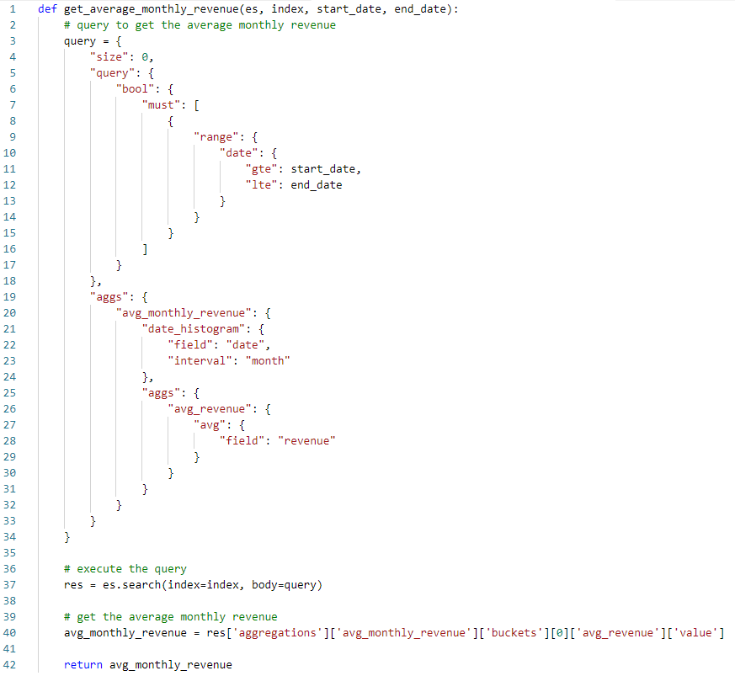
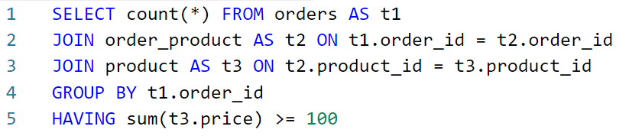
Examples What would it look like?
Method to calculate the average monthly revenue in ElasticSearch
How many orders have products that their prices sum up to 100 or more?
Database schema
orders:
order_id
order_product:
order_id
product_id
product:
product_id
price

Slide 5





What is going on In the text-to-code space
“
50%
Of new website and mobile app code will be created by generative AI using machine learning models.*
OpenAI’s Codex model, which derives from its GPT-3 model, is specifically designed to generate code from English language requests. Microsoft plans to commercialize this via its GitHub Copilot offering.*
2026
30%
Of enterprises will have implemented an AI-augmented development and testing strategy, up from 5% in 2021.*
“
AlphaCode achieved an estimated rank within the top 54% of participants in programming competitions by solving new problems that require a combination of critical thinking, logic, algorithms, coding, and natural language understanding.**
2025
* Predicts 2022: Generative AI Is Poised to Revolutionize Digital Product Development, Gartner.
** Competitive programming with AlphaCode, DeepMind.
Notes:
OpenAi, Github, Microsoft: Codex
Microsoft: CodeXGLUE
IBM: CodeNet

Slide 6


Ecosystem Models and datasets for general purpose programming languages
 | Model | Base model | Dataset | Model size | Dataset Size
 | OpenAI’s Codex | GPT | GitHub | 12 Billion parameters | 54 Million repositories 159 GB of Python code
 | GPT-2, GPT-3, GPT-Neo | GPT | APPS | 1.5, 2.7, 175 Billion parameters | 10.000 programming problems 232,421 Python code samples 131,777 Python test cases
 | EleutherAI’s GPT-J | GPT | The Pile | 6 Billion parameters | 95,16 GB of GitHub code
 | DeepMind’s AlphaCode | - | GitHub CodeContests | 41 Billion parameters | 715,1 GB of GitHub code 13.610 programming problems
 | Microsoft’s CodeGPT | GPT | CodeSearchNet | 124 Million parameters | 1,1 Million Python functions 1,6 Million Java methods

Slide 7


Ecosystem Models and datasets for SQL
 | Model (SOTA Benchmark) | Base model | Dataset | Model size | Dataset Size
 | SeaD + Execution-Guided Decoding | Facebook’s BART (Large) | WikiSQL | 400 Million parameters | 80.654 questions and SQL queries 24241 tables
 | T5-3B + PICARD | Google’s T5-3B | Spider | 3 Billion parameter | 10,181 questions 5.693 queries 200 databases 138 domains

Slide 8



State of the Art
HumanEval
164 Low to high complexity problems
APPS
1000 Low complexity problems
Python
Evaluation
Measuring the actual model’s problem-solving skills by functionally evaluating the generated code.
Models are allowed to generate k solutions per problem which are validated by unit testing them.
The problem is considered solved if at least one of k solutions passes all the unit tests.
Codes are tested against specific data sets containing certain number of problems
Min
Max
Min
Max
HIGH RESOLUTION RATES
K = 1
6,41%
28,81%
3,90%
22,78%
2
1
2
1
K = 100
21,37%
72,31%
--
--
2
1
K = 1K
--
--
17,67%
25,02%
3
1
HIGH ROBUSTNESS
1
Codex
GPT-Neo
2
3
AlphaCode
SQL
WikiSQL
15.878 Low complexity queries
Spider
Low to high complexity queries*
Evaluation
Two criteria can be applied:
Generated queries are assessed by comparing its logical construction to a golden query.
Functional correctness is also evaluated by matching returned results from a testing database.
Logical
87,5%
72,1%
4
5
CONSIDERED FOR COMMERCIAL APPLICATIONS
Execution
93,0%
75,1%
4
6
4
SeaD + Execution – Guided Decoding
5
S²SQL + ELECTRA
6
T5-3B+PICARD
* Exact number of test queries is not provided
Notes:
El rendimiento de Codex es muy parecido entre la evaluación sobre HumanEval (28,81%) y APPS (22,78%) (k=1). Esto demuestra la robustez del modelo que obtiene meticas similares al ser evaluado sobre dos datasets totalmente independientes.
Elevados porcentajes de generación de código correcto:
* 72,31% en HumanEval con Codex (K=100)
* 20%~30% en HumanEval y APPS con Codex (K=1)
La robustez y los porcentajes elevados de éxito, sobre todo para K=1 (que propone un mayor reto para los modelos al tener solo una oportunidad de generar el código correcto para cada uno de los problemas), demuestran una habilidad de programación por parte de estas soluciones que merece ser considerada para aplicarse al desarrollo de aplicaciones comerciales.
El numero de preguntas y queries usadas para las pruebas de los dos modelos sobre Spider no está especificado en las publicaciones. Pueden cambiar según el modelo probado y el tipo de prueba. Como aproximación, uno de los tipos de prueba publicado (no usado en estas pruebas) contiene 2147 queries de prueba. Otra separación propuesta (usada en el caso de (5)) es usar un conjunto de prueba con 40 bases de datos distintas no usadas para el entrenamiento (pero no se indica el número de queries sobre estas bases de datos)

Slide 9



Benefits How AI Pair Programming will impact business?
Development effort reduction
The cost of building software is reduced promoted by:
Automatic code generation:
General applications
Testing applications
Code migration
Reduced code review needs
Staffing of non-specialized developers The lack of technical profiles for software development tasks can be solved by introducing non-specialized profiles for coding from natural language
Alternative solutions to the same problem For a given problem, new ways of solving it can be generated by presenting to the developer more optimized, robust or idiomatic solutions
Notes:
1. Reduce esfuerzos en el proceso de desarrollo
Haciendo más productivos a los desarrolladores sugiriéndoles múltiples implementaciones del código en el que están trabajando, escribiéndoles los tests unitarios de las funcionalidades, o incluso automatizando partes de la implementación de un producto de software.
2. Facilita el desarrollo de código simple por parte de usuarios no altamente especializados
Haciendo más accesible la tarea de desarrollar, asistiendo a los usuarios sin un alto nivel de especialización con terminaciones, sugerencias o documentación.
3. Proporciona abordajes alternativos a un problema
Sugerirle diferentes soluciones a un desarrollador para un mismo problema puede aportar puntos de vista diferentes, dando lugar a soluciones más optimizadas, seguras, robustas, idiomáticas, …

Slide 10
Benefits Cost reduction in coding
Taking as a reference the estimators approved by Accenture, it is shown a high-level estimation of efficiency only for the Build phase for both Python and SQL.
Python
SQL
Assumption | Value
Number of Medium complexity factors – Controller modules for an MVC architecture | 10
Time required for coding a Medium complexity module | 72,5 hours*
% Efficiency for coding a Medium complexity module with AI | 20%
LCR (Spain) | 28,38 €
Language | Python/.NET/Java
Assumption | Value
Number of Medium complexity factors – Considers 3-6 SQL queries to a database with multiple tables and relations | 10
Time required for coding a Medium complexity access | 108,3 hours*
% Efficiency for writing a Medium complexity factor with AI | 70%
LCR (Spain) | 28,38 €
Language | SQL
Total Cost
Total Cost
Traditional Approach
AI-assisted Approach
Traditional Approach
AI-assisted Approach
20,6 K€
16,5 K€
30,7 K€
9,2 K€
*Reference: ADM - https://admestimator.accenture.com/

Slide 11



PoC Approach & Scope
In order to assess the technology, a PoC is proposed for which a real Accenture’s deal must be picked where to partially replicate its code with the code generated by AI. The approach would be:
1.
2.
3.
Analysis & Design
Execution
Evaluation & Conclusions
Pick a stable solution already deployed in production in an Accenture deal for each language: Python, SQL and Cobol
Identify a subset of 30 functionalities* for each language to replicate and to evaluate the performance of the different solutions Obtain the functional and technical design document
Obtain the code and testing scripts associated to the solution selected
Identify key people from Accenture involved in the deal for each programming language under analysis: Python, SQL and Cobol
In case of Cobol original code and functional design must be provided in order to build the training corpus
Based on existing benchmarks, select the best AI model and associated metrics Gather from the technical design the specific paragraphs to be used in the AI Pair Programming solution
If required, specify in natural language the different functional components
Run Python, SQL and Cobol code generation based on natural language specifications
In the case of Cobol, a model must be generated for this purpose
Adjust configuration both in the input text and models’ parameters
Run the provided testing scripts against the code generated and capture metrics
Assess the quality of the technical documents for this type of approach
Evaluate code quality
Evaluate results on obtained metrics Evaluate the potential productivity growth
Present results
Python
SQL
* Functionality means a method in OOP, a query in SQL or a sub-routine in Cobol
Notes:
Añadir COBOL
High level business case
Añadir equipo
COBOL
Problema, app

Slide 12

Plan
According to the approach presented, the plan to overcome the effort is:
Activity | Week 1 | Week 2 | Week 3 | Week 4 | Week 5 | Week 6 | Week 7 | Week 8 | Week 9 | Week 10 | Week 11
Target solutions analysis, data gathering and preparation
Selection of model, evaluation tools and metrics
Environment and evaluation set-up building
Generate model for Cobol
Execute code generation and adjust input/specification: Cobol
Execute code generation and adjust input/specification: Python
Execute code generation and adjust input/specification: SQL
Evaluate the code generated on the selected metrics, code quality, and input
Evaluate productivity growth
Presentation of results
Activities
SQL
COBOL
Python
Functional and technical design
Code generated
Ad-hoc Cobol model
Performance metrics
Deliverables
Final Presentation
Kick-off meeting
Weekly meeting
Language performance
Iterative

Slide 13





Team
For the execution of the project, it is recommended that the team of the assigned client has a series of qualified profiles with levels of training and experience that allow them to undertake the tasks.
AI Architect & PoC Responsable
1x part-time: 10%
Provides knowledge about the business sector as well as NLP and the exploitation of its capabilities. Coordinates the execution of the PoC.
Sr AI Engineer
1x full-time
Knowledge of NLP focused on natural language generation. Experts in the development of Python models and solutions.
AI Intern
1x part-time: 50%
Knowledge of NLP. Will take care of the data analysis and preparation. Also, will be focused on the generation of natural language specifications for each functionality.
SME AI
1x part-time: 5%
Specialist in Natural Language Processing. Provides knowledge and experience for the development and coordination of the project to meet the defined objectives.
Deal’s Solutions SME
3x part-time: 5%
People with knowledge in the languages to be generated (Python, SQL and Cobol) but fundamentally in the solutions that will be recreated using AI.

Slide 14
Economic Estimation
Based on the scope, activities and resources considered for this effort, the associated cost is:
Development costs
Infra costs
Approximate costs for the whole duration of the PoC
Profile | Hours | Unloaded Rate | Total
AI Intern L11 | 191 | 7,50 € | 1.434 €
AI Sr Engineer L10 | 468 | 27,88 € | 13.034 €
AI Architect L8 | 47 | 39,60 € | 1.851 €
AI SME L5 | 23 | 90,31 € | 2.111 €
Cobol Solution SME L10 | 24 | 27,88 € | 669 €
Python Solution SME L10 | 12 | 27,88 € | 335 €
SQL Solution SME L10 | 12 | 27,88 € | 335 €
Total cost |  |  | 19.769 €
Infrastructure / Hardware | 2000 € | Infrastructure with sufficient hardware requirements to cover the needs of model training and inference given the size of the State-of-the-Art models. 32GB GPU and 100GB Disk
Environments | 100 € | Tools and software needed to create and deploy the solutions and to evaluate the functional performance of the generated code by running and unit testing it. IDE, Python interpreter and environment manager, COBOL compiler, SQL Database server (4GB), Docker.
License and access to OpenAI Codex | 1500 € | License to consume the OpenAI API to infer from the Codex model.* Tokens per functionality: 200 Number of functionalities: 30 Number of code generations per language: 1000
Total cost | 3.600 €
* Desirable to have access to API through the partnership Accenture has with OpenAI

Slide 15
Additional needs
Need | Description
Data set for Cobol | Dataset containing 10k lines of COBOL code in the shape of well documented subroutines. Needed to fine-tune models for COBOL code generation.
Code | For each language, the code base of a stable production solution will be taken from an Accenture deal. Each functionality must be well documented. In the case of Python and COBOL, unit tests with a high coverage percentage will be required. In the case of SQL, a dump of the targeted database will be also needed.

Slide 17
State of the Art Conclusions
1.
The highest percentages of correct generated code are:
72,31% for Python in HumanEval with Codex and K=100
22,78% ~ 28,81% for Python in APSS and HumanEval with Codex and K=1
72,1% ~ 93% for SQL on Spider and WikiSQL
2.
Codex's performance is very similar between the evaluation on HumanEval and APPS for k = 1. This demonstrates the robustness of the model that obtains similar metrics when evaluated on two totally independent datasets.
3.
The elevated success rates and the robustness of the models, especially for K=1 (which is the greatest challenge for the models as it gives only one opportunity to generate the correct code for each of the problems), demonstrate that these solutions have a programming ability that deserves to be taken in consideration in the development of commercial applications.

